Slide 1
Data Science
General Assembly Lecture 3
Instructor: Hamed Hasheminia

Slide 2
LEARNING OBJECTIVES
STATISTICS FUNDAMENTALS
Data Manipulation. Adding/removing columns and adding/removing observations
Create data visualizations - including: boxplots, histograms- and scatterplots to discern characteristics and trends in a dataset
Use NumPy and Pandas libraries to analyze datasets using basic summary statistics: mean, median, mode, max, min, quartile, inter-quartile range, variance, standard deviation, and correlation, skewness coefficient
Outliers
Central Limit Theorem
ID variable types and creating dummy variables

Slide 3
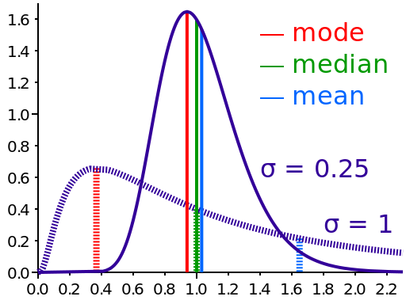
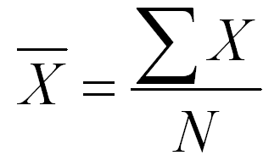
MEAN
The mean of a set of values is the sum of the values divided by the number of values. It is also called the average.

Slide 4
MEAN EXAMPLE
Find the mean of 19, 13, 15, 25, and 18.
19 + 13 + 15 + 25 + 18 90
--------------------------- = ----- = 18
5 5

Slide 5
MEDIAN
The median refers to the midpoint in a series of numbers.
To find the median
Arrange the numbers in order smallest to
largest.
If there is an odd number of values, the
middle value is the median.
If there is an even number of values, the
average of the middle two values is the median.

Slide 6
MEDIAN EXAMPLE
Find the median of 19, 29, 36, 15, and 20.

Slide 7
MEDIAN EXAMPLE
Find the median of 19, 29, 36, 15, and 20.
Ordered Values:
15, 19, 20, 29, 36
20 is the median

Slide 8
MEDIAN EXAMPLE
Find the median of 67, 28, 92, 37, 81, 75.
Ordered Values:
28, 37, 67, 75, 81, 92
67 and 75 are the middle values.
67 + 75 142
---------- = ------ = 71
2 2
71 is the median.

Slide 9
MODE
The mode of a set of values is the value that occurs most often.
A set of values may have more than one mode or no mode.

Slide 10
MODE EXAMPLE
Find the mode of 15, 21, 26, 25, 21, 23, 28, and 21.

Slide 11

MODE EXAMPLE
Find the mode of 15, 21, 26, 25, 21, 23, 28, and 21.
15 21 23 25 26 28
21 is the mode because it occurs most frequently

Slide 12
MODE EXAMPLE
Find the mode of 12, 15, 18, 26, 15, 9, 12, and 27.

Slide 13
MODE EXAMPLE
Find the mode of 12, 15, 18, 26, 15, 9, 12, and 27.
9 12 15 18 26 27
12 and 15 are the modes since the both occur twice.

Slide 14
MODE EXAMPLE
Find the mode of 4, 8, 15, 21, and 23.

Slide 15
MODE EXAMPLE
Find the mode of 4, 8, 15, 21, and 23.
4 8 15 21 23
There is no mode since all values occur the same number of times.

Slide 16
CODEALONG PART 1: BASIC STATS
We can use Pandas to calculate the mean, median, mode, min, and max.
Methods available include: .min() - Compute minimum value .max() - Compute maximum value .mean() - Compute mean value .median() - Compute median value .mode() - Compute mode value .count() - Count the number of observations

Slide 17
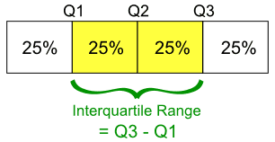
QUARTILES AND INTERQUARTILE RANGE
Quartiles divide a rank-ordered data set into four equal parts.
The values that divide each part are called first, second, and third quartiles, denoted Q1, Q2, and Q3, respectively.
The interquartile range (IQR) is Q3 - Q1, a measure of variability.

Slide 18
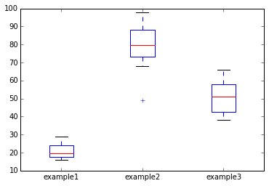
CODEALONG PART 2: BOX PLOT
Box plots give a nice visual of min, max, mean, median, and the quartile and interquartile range.

Slide 19
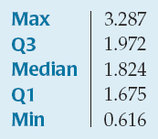
Five-Number Summary
The five-number summary of a distribution reports its median, quartiles, and extremes (maximum and minimum).

Slide 20
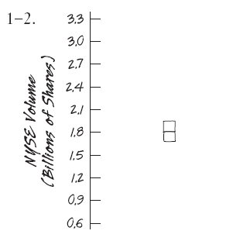
Boxplots
Once we have a five-number summary of a variable, we can display that information in a boxplot. To make a boxplot:
Draw a single vertical axis spanning the extent of the data.
Draw short horizontal lines at the lower and upper quartiles and at the median. Then connect them with vertical lines to form a box

Slide 21
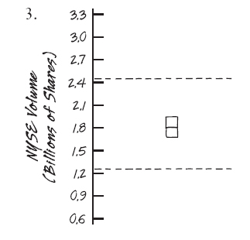
Boxplots
3) Erect (but don’t show in the final plot) “fences” around the main part of the data, placing the upper fence 1.5 IQRs above the upper quartile and the lower fence 1.5 IQRs below the lower quartile.

Slide 22
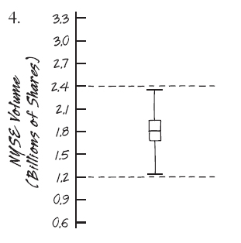
Boxplots
4) Draw lines (whiskers) from each end of the box up and down to the most extreme data values found within the fences.

Slide 23
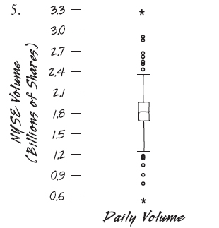
Boxplots
5) Add any outliers by displaying data values that lie beyond the fences with special symbols.

Slide 24
Boxplots
The center of a boxplot shows the middle half of the data between the quartiles – the height of the box equals the IQR.
If the median is roughly centered between the quartiles, then the middle half of the data is roughly symmetric. If it is not centered, the distribution is skewed.
The whiskers show skewness as well if they are not roughly the same length.

Slide 25
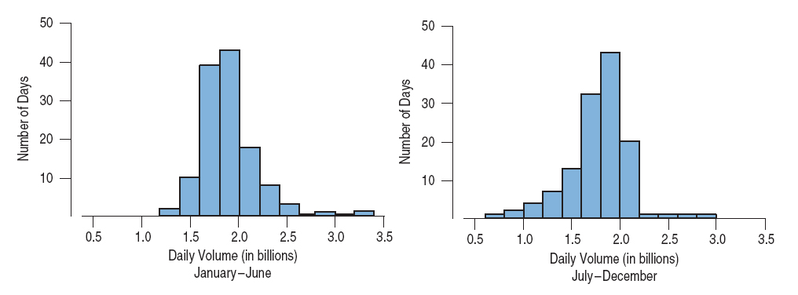
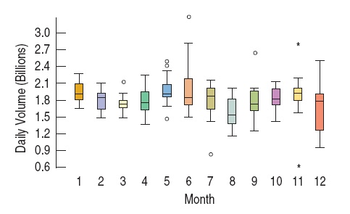
Comparing Groups

Slide 26
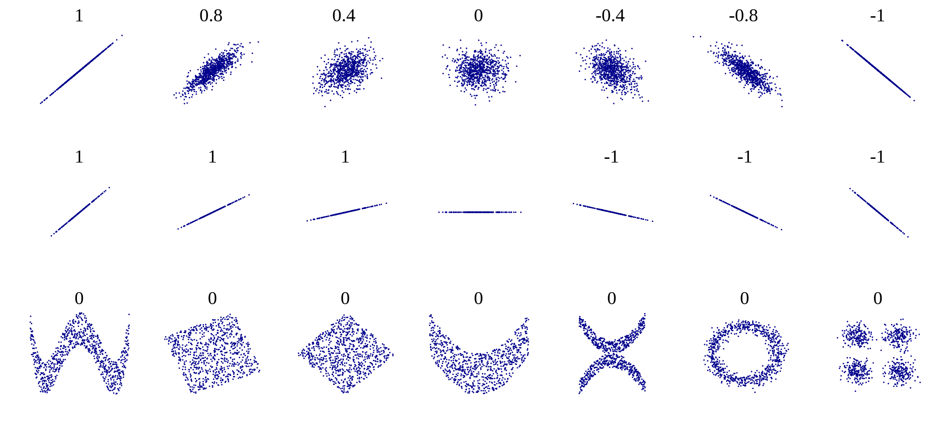
CORRELATION
The correlation measures the extent of linear interdependence of variable quantities.
Example correlation values

Slide 27
INTRODUCTION
IS THIS NORMAL?

Slide 28
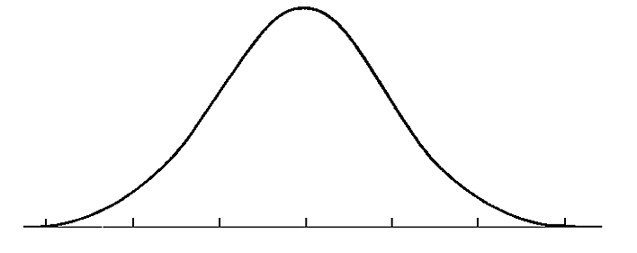
THE NORMAL DISTRIBUTION
A normal distribution is often a key assumption to many models.
The normal distribution depends upon the mean and the standard deviation.
The mean determines the center of the distribution. The standard deviation determines the height and width of the distribution.

Slide 29
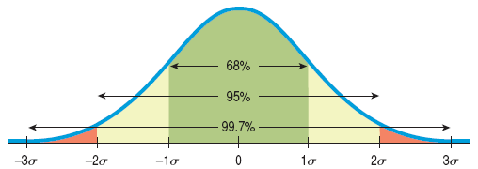
The 68-95-99.7 Rule (the Empirical Rule)
In bell-shaped distributions, about 68% of the values fall within one standard deviation of the mean, about 95% of the values fall within two standard deviations of the mean, and about 99.7% of the values fall within three standard deviations of the mean.

Slide 30
Practice with Normal Distribution Calculations
Example 1: Each Scholastic Aptitude Test (SAT) has a distribution that is roughly unimodal and symmetric and is designed to have an overall mean of 500 and a standard deviation of 100.
Suppose you earned a 600 on an SAT test. From the information above and the 68-95-99.7 Rule, where do you stand among all students who took the SAT?

Slide 31
Practice with Normal Distribution Calculations
Example 1 (continued): A score of 600 is 1 SD above the mean. That corresponds to one of the points in the 68-95-99.7% Rule.
About 32% (100% – 68%) of those who took the test were more than one SD from the mean, but only half of those were on the high side.
So about 16% (half of 32%) of the test scores were better than 600.

Slide 32
Practice with Normal Distribution Calculations
Example 2: Assuming the SAT scores are nearly normal with N(500,100), what proportion of SAT scores falls between 300 and 600?

Slide 33
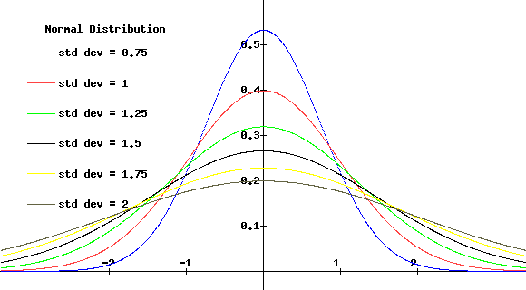
THE NORMAL DISTRIBUTION
Normal distributions are symmetric, bell-shaped curves.
When the standard deviation is large, the curve is short and wide.
When the standard deviation is small, the curve it tall and narrow.

Slide 34
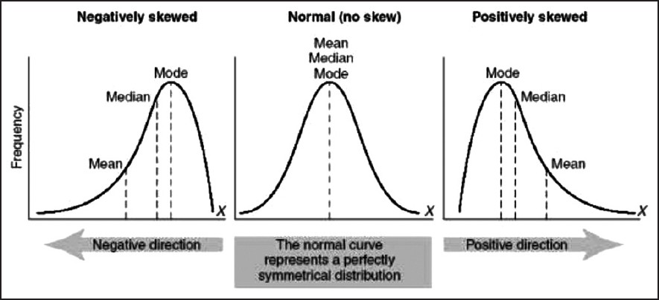
SKEWNESS
Skewness is a measure of the asymmetry of the distribution of a random variable about its mean.
Skewness can be positive or negative, or even undefined.

Slide 35
DEMO
CLASSES

Slide 36
CLASS/DUMMY VARIABLES
Let’s say we have the categorical variable area, which takes on one of the following values: rural, suburban, and urban.
We need to represent these numerically for a model. So how do we code them?

Slide 37
CLASS/DUMMY VARIABLES
How about 0=rural, 1=suburban, and 2=urban?

Slide 38
CLASS/DUMMY VARIABLES
No, that implies that urban is twice suburban, an ordered relationship. This doesn’t make sense.
However, we can represent this information by converting the one area variable into two new variables, area_urban and area_suburban.

Slide 39
CLASS/DUMMY VARIABLES
We’ll draw out how categorical variables can be represented without implying order.
First, let’s choose a reference category. This will be our “base” category.
It’s often good to choose the category with the largest sample size and a criteria that will help model interpretation. If we are testing for a disease, the reference category would be people without the disease.

Slide 40
CLASS/DUMMY VARIABLES
Step 1: Select a reference category. We’ll choose rural as our reference category.
Step 2: Convert the values urban, suburban, and urban into a numeric representation that does not imply order.
Step 3: Create two new variables: area_urban and area_suburban.

Slide 41
CLASS/DUMMY VARIABLES
Why do we need only two dummy variables?
We can derive all of the possible values from these two. If an area isn’t urban or suburban, we know it must be rural.
In general, if you have a categorical feature with k categories, you need to create k-1 dummy variable to represent all of the information.
rural | urban | suburban

Slide 42
CLASS/DUMMY VARIABLES
Let’s see our dummy variables.
As mentioned before, if we know area_urban=0 and area_suburban=0, then the area must be rural.
 | area_urban | area_suburban
rural | 0 | 0
suburban | 0 | 1
urban | 1 | 0

Slide 43
CLASS/DUMMY VARIABLES
We can do this for a gender variable with two categories: male and female.
How many dummy variables need to be created?

Slide 44
CLASS/DUMMY VARIABLES
# of categories - 1 = 2 -1 = 1

Slide 45
CLASS/DUMMY VARIABLES
We will make female our reference category. Thus, female=0 and male=1.
This can be done in Pandas with the get_dummies method.
 | gender_male
female | 0
male | 1

